Slide 1
IEEE MPCON 2026
CORRELATION MAPPING OF SANITATION ACCESS AND PUBLIC HEALTH OUTCOMES IN TAMIL NADU
Authors :
Dr. Deepalakshmi Rajendran
Mrs. M. Surya
Annie Darling Kanmani A
Dharun R
Isac Reegan G
Danish Sugarstan S

Slide 2
INTRODUCTION
Sanitation is a fundamental determinant of public health and social well-being.
In many developing regions, inadequate sanitation leads to:
• Waterborne diseases
• Poor environmental hygiene
• Increased healthcare burden
TamilNadu has made significant progress in sanitation infrastructure, but disparities still exist across districts.
Understanding the relationship between sanitation access and health outcomes canhelp policymakers improve public health strategies.
01

Slide 3
PROBLEM STATEMENT
Despite improvements in sanitation facilities, many regions still experience poor health outcomes.
Key challenges include:
• Unequal access to sanitation facilities
• Inadequate waste management systems
• Lack of data-driven policy decisions
Therefore, there is a need to analyze the relationship between sanitation access and public health indicators using statistical methods.

Slide 4
RESEARCH OBJECTIVES
The objectives of this study are:
• To analyze sanitation accessibility across Tamil Nadu
• To evaluate the relationship between sanitation access and public health outcomes
• To identify patterns using correlation analysis
• To provide insights for improving sanitation policies

Slide 5
DATASET AND STUDY AREA
The study focuses on Tamil Nadu districts.
Key variables analyzed
Sanitation indicators:
• Household toilet access
• Waste disposal facilities
Health indicators:
• Disease incidence rates
• Public health statistics
Data sources include:
• Government public health records
• Sanitation access statistics
• Population health indicators
04

Slide 6
METHODOLOGY
The study follows a data-driven analytical approach.
Steps involved:
1. Data collection from official datasets
2. Data cleaning and preprocessing
3. Statistical correlation analysis
4. Visualization and interpretation
Tools used:
• Python
• Statistical analysis techniques
• Data visualization methods

Slide 7
CORRELATION ANALYSIS
The relationship between sanitation and public health outcomes is measured using the
Pearson Correlation Coefficient.
Formula:
r = Σ (xi − ̄x)(yi − ȳ)
───────────────
√[ Σ (xi − ̄x)2 Σ (yi − ȳ)2 ]
Where:
xi = sanitation indicator values
yi = health outcome values
̄x = mean of sanitation values
ȳ = mean of health values
Interpretation:
• r = +1 → strong positive relationship
• r = 0 → no relationship
• r = −1 → strong negative relationship

Slide 8
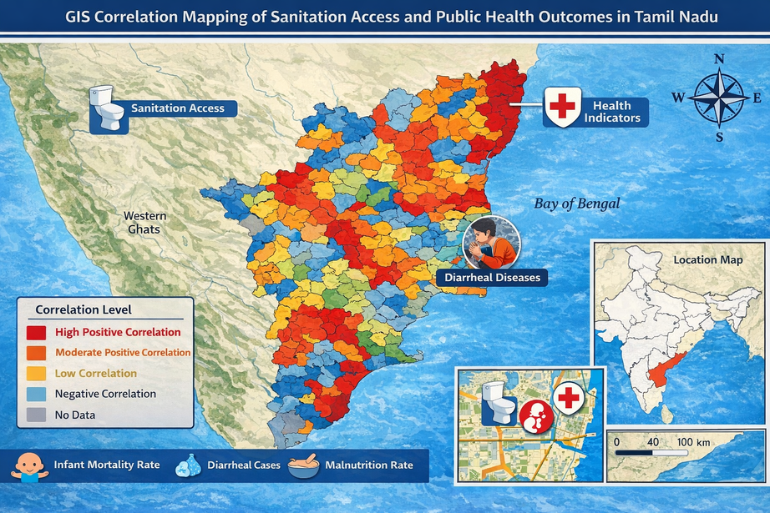
DATA VISUALIZATION
To better understand the relationships, the study uses visual techniques such as :
• Correlation heatmaps
• Scatter plots
• District-level comparison graphs
These visualizations help identify patterns between sanitation availability and disease prevalence.

Slide 9
FUTURE WORK
Future research can expand this study by:
• Including additional states for comparison
• Using machine learning models for prediction
• Analyzing long-term sanitation trends
• Incorporating environmental factors such as water quality
These improvements will help develop more accurate public health models.

Slide 10
CONCLUSION
This study examined the relationship between sanitation access and public health
outcomes in Tamil Nadu.
Key conclusions:
• Sanitation access has a measurable impact on health outcomes.
• Correlation analysis helps identify critical sanitation gaps.
• Improved sanitation infrastructure can significantly enhance public health.
Strengthening sanitation systems will contribute to sustainable and healthy
communities.

Slide 11
REFERENCES
[1] National Family Health Survey (NFHS-5), 2019–21:
Tamil Nadu Fact Sheet, International Institute for Population
Sciences (IIPS), Mumbai, India, 2021. Available:
[2] P. Prithviraj, P. Sivaprakasam, C. Mahendran, P. Norman, and
K. R. Pandyan, “Status of sanitation in the rural areas of a
health unit district, Tamil Nadu, India,” Natl. J. Community
Med., vol. 8, no. 09, pp. 521–525, 2017.
[3] Assessment of water, sanitation and hand hygiene
practices in rural households of Tamil Nadu: A cross?
sectional study,” J. Family Med. Prim. Care, 2024.

Slide 12
THANK YOU
THANK YOU FOR YOUR ATTENTION
Questions and discussions are welcome!
THANK YOU FOR YOUR ATTENTION
QUESTIONS AND DISCUSSIONS ARE WELCOME!

